Slide 1
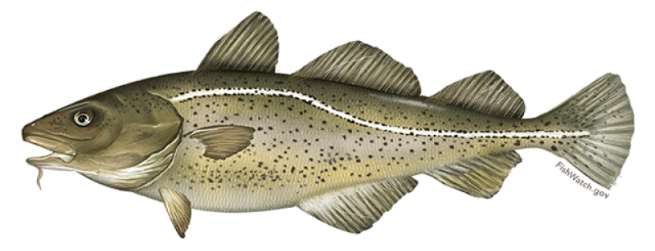

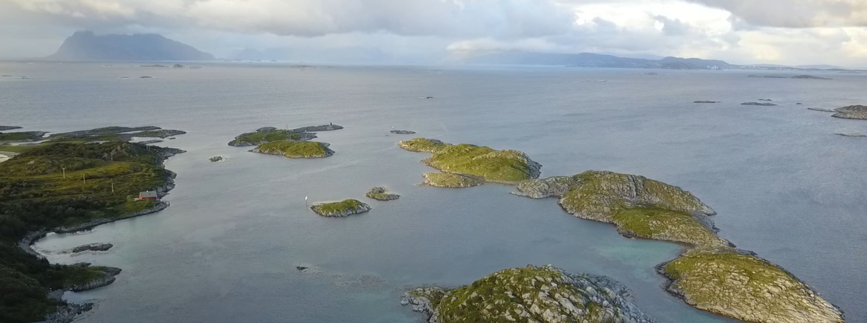
IMR survey dataset examples

Slide 2
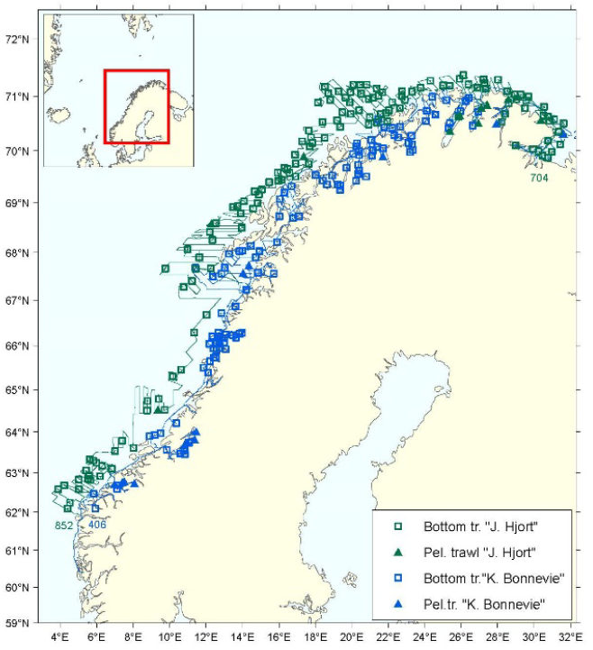
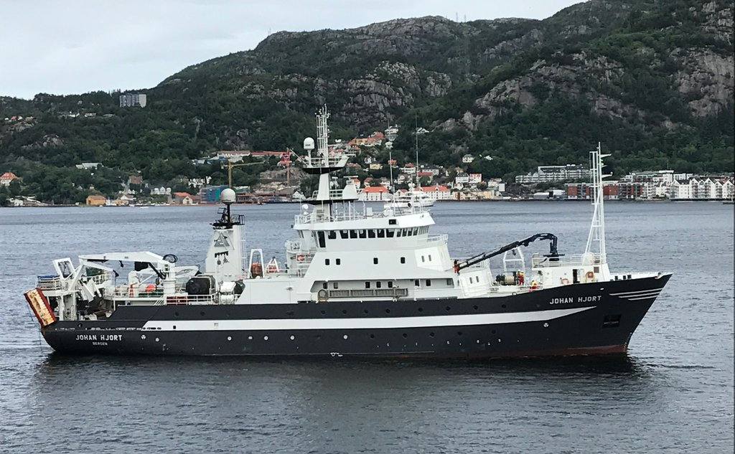
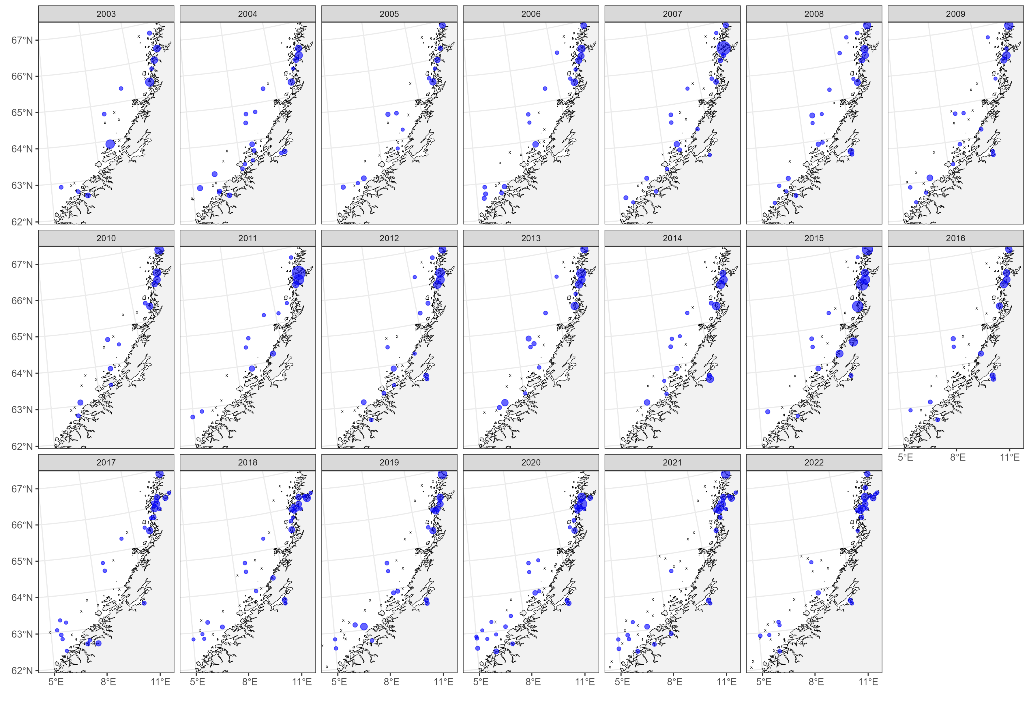



Coastal acoustic-trawl survey
Cod, south of 67N
Lower precision and consistency than in north
Notes:
“Acoustic and trawl indices of biomass of age 2+ may be used in biomass models or to assess changes in stock abundance from year to year, using methods for data-poor stocks.”

Slide 3
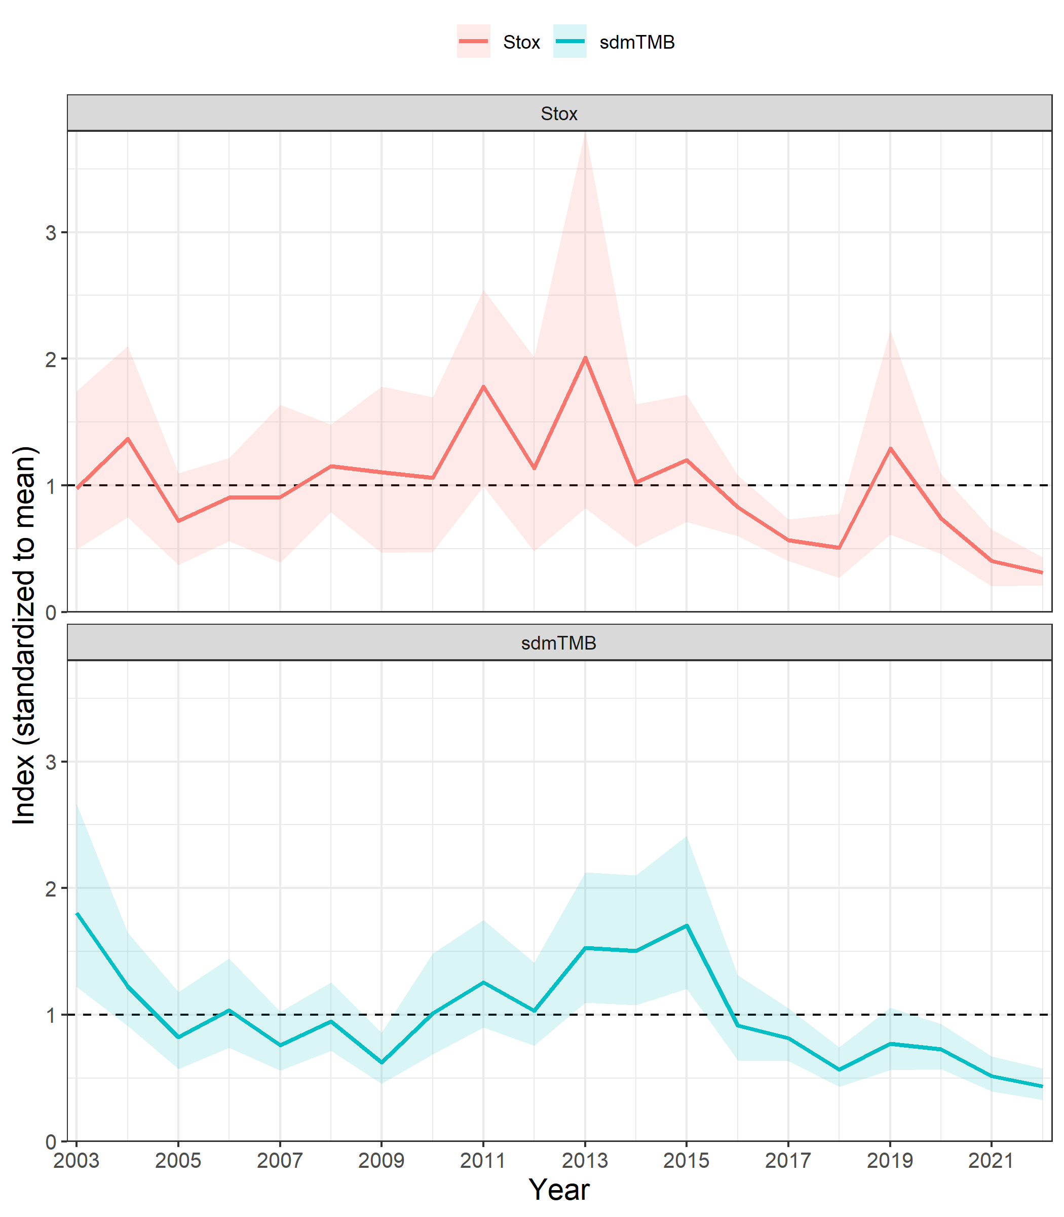
Coastal acoustic-trawl survey
Possible challenges for YOU to solve!
Use sdmTMB to create an abundance index
What covariates?
Which distribution (compare tweedie and delta_gamma)?
Spatial? Spatiotemporal?
How does your index compare to the swept area index from Stox?
Change the resolution of the mesh and projection grid
How much do they affect the index?
Compare alternative methods for making the projection grid
Rectangular grid, full lon/lat extent – how does this affect the index CV?
Cover all the data locations at a specified resolution (code does this currently)
Use mesh vertices: https://github.com/pbs-assess/sdmTMB/discussions/230
Create a regular grid and then clip to the strata polygons
Try a barrier mesh
exercises/coastal-survey-ex/coastal-survey-index-south.R
Notes:
“Acoustic and trawl indices of biomass of age 2+ may be used in biomass models or to assess changes in stock abundance from year to year, using methods for data-poor stocks.”

Slide 4
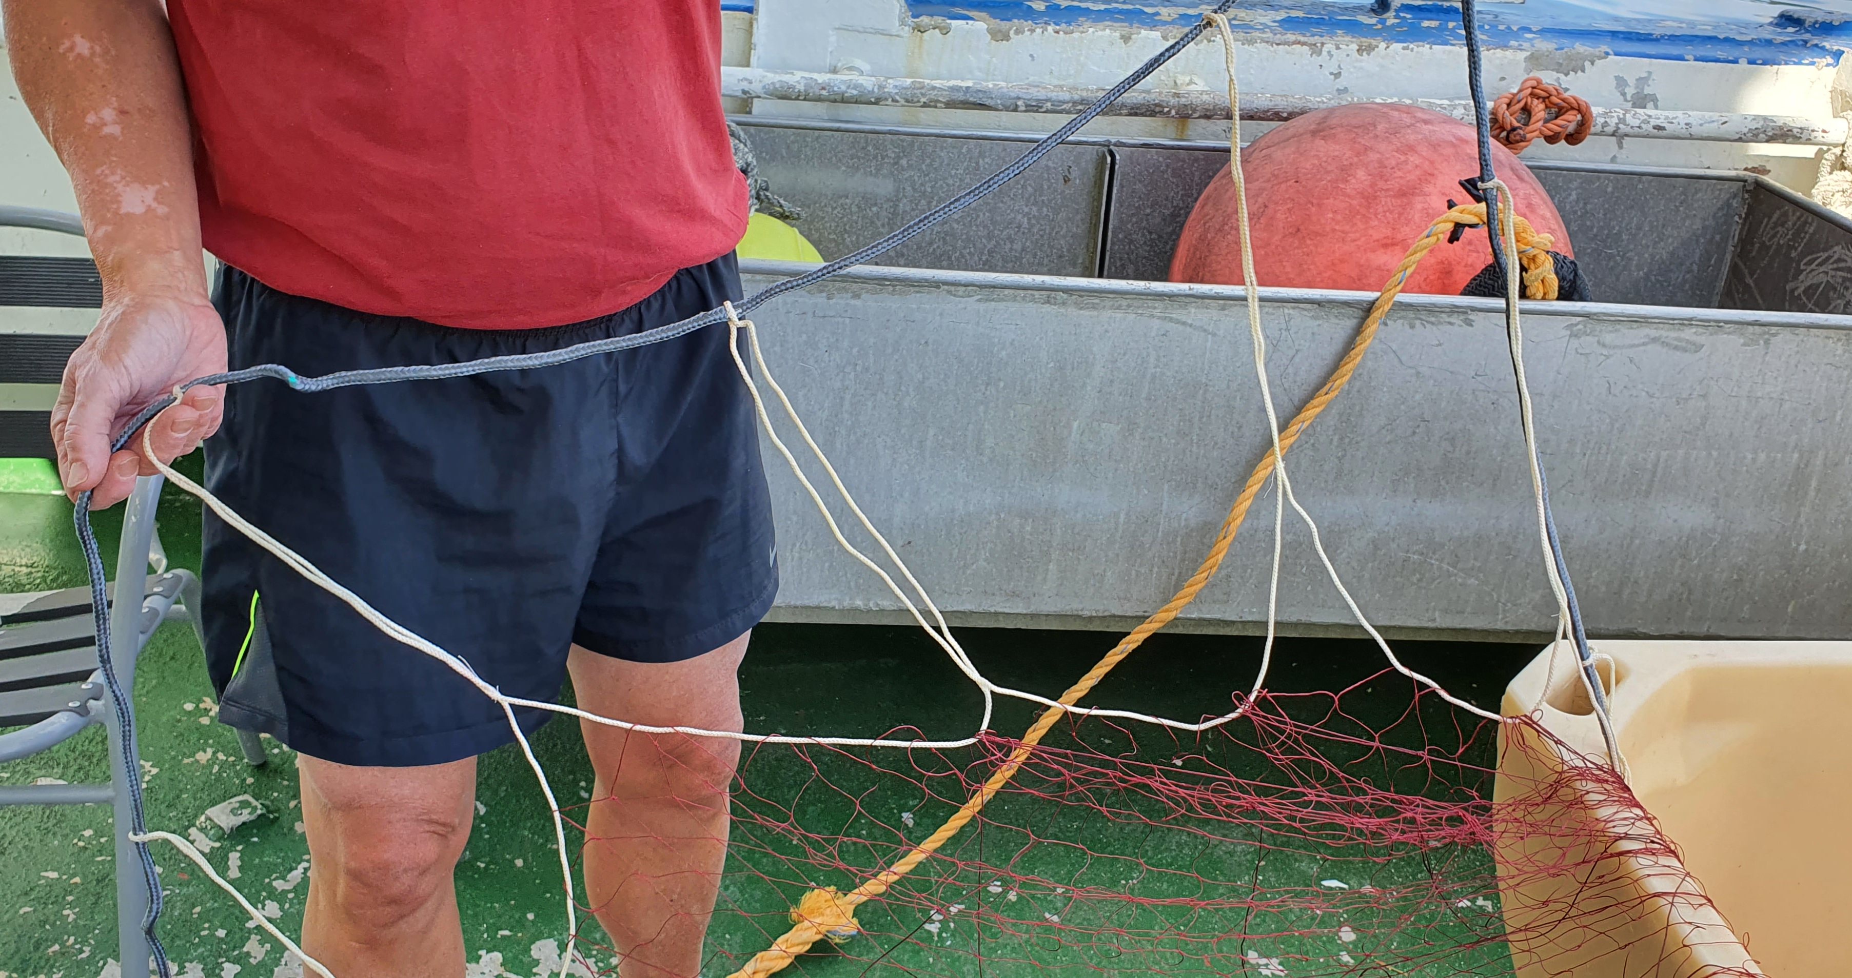
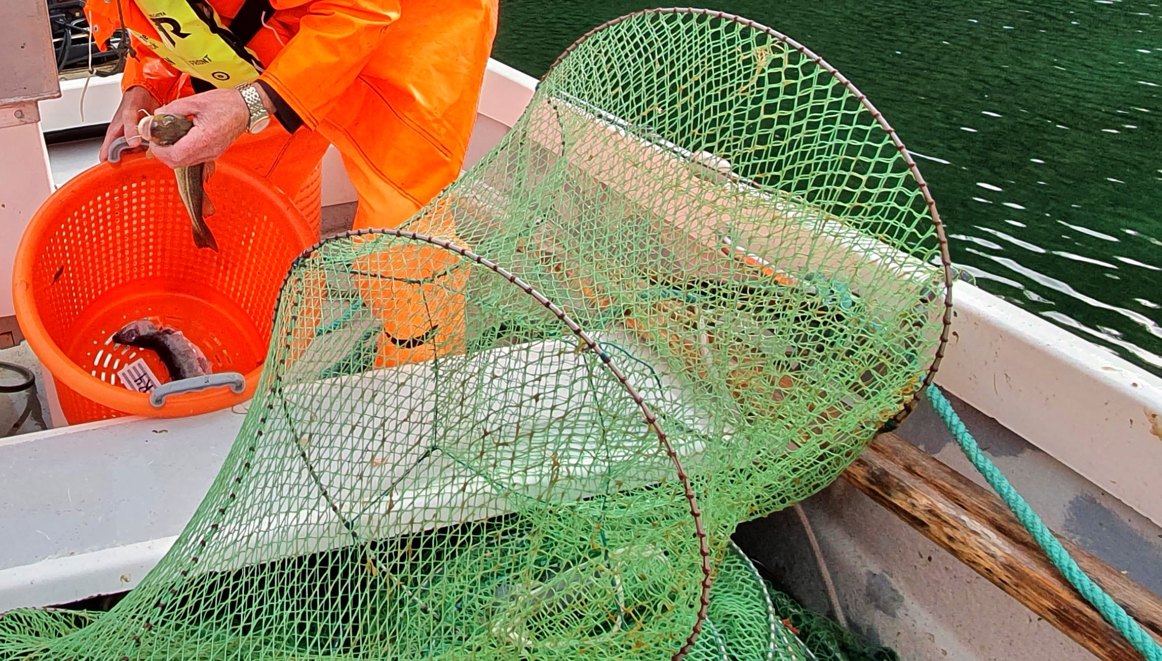
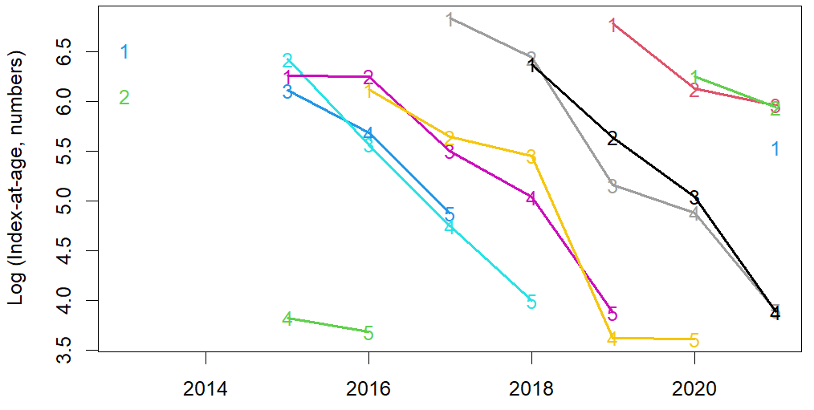
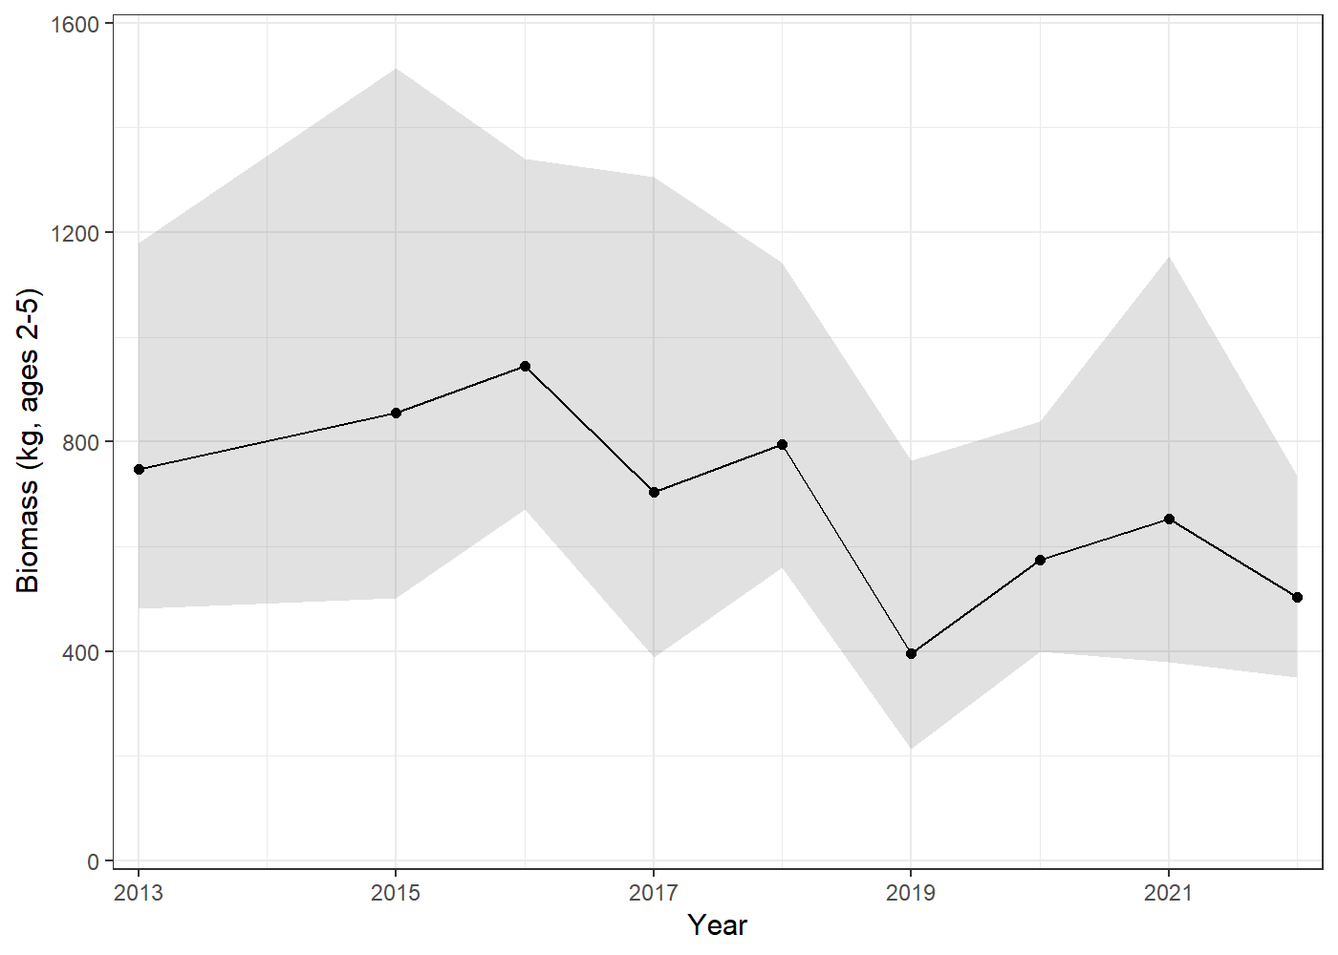
Shallow net survey
One ‘site’ =
6 ruse + 2 garn_{45mm} + 2 garn_{36mm}
Garn / trammel
10-25 m
36 mm
45 mm
Ruse / fyke
2-10 m
Eidset 2019
sdmTMB models for each age 0-5
tracks cohorts

Slide 5
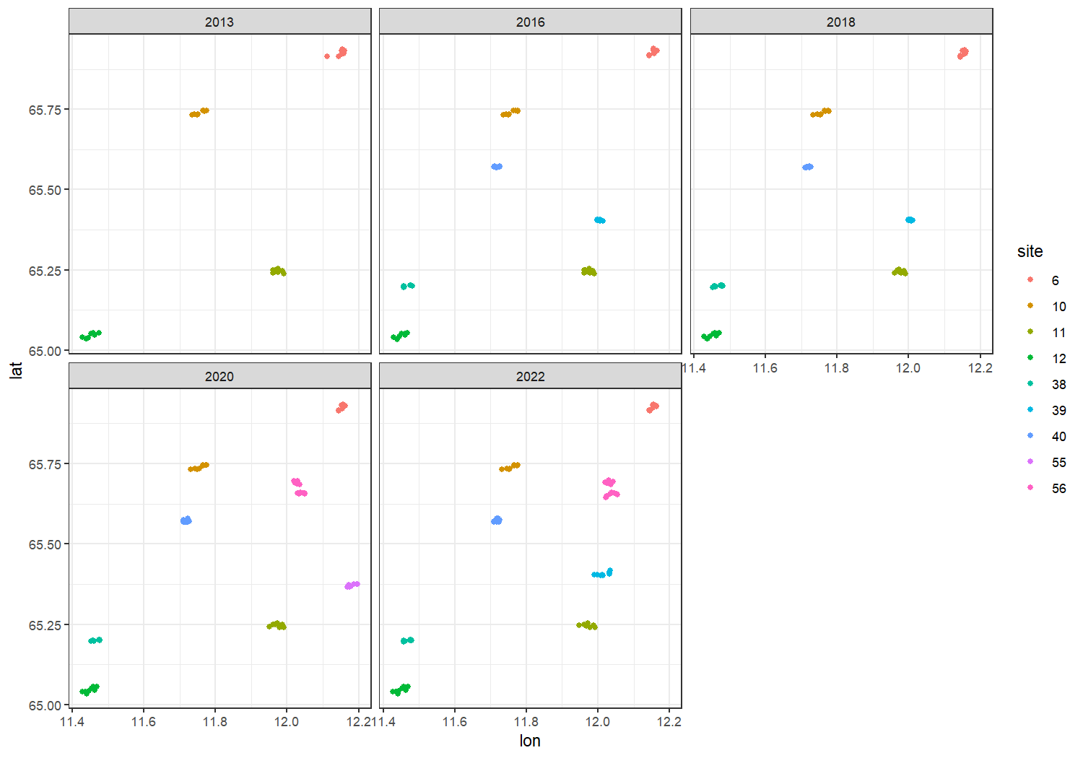
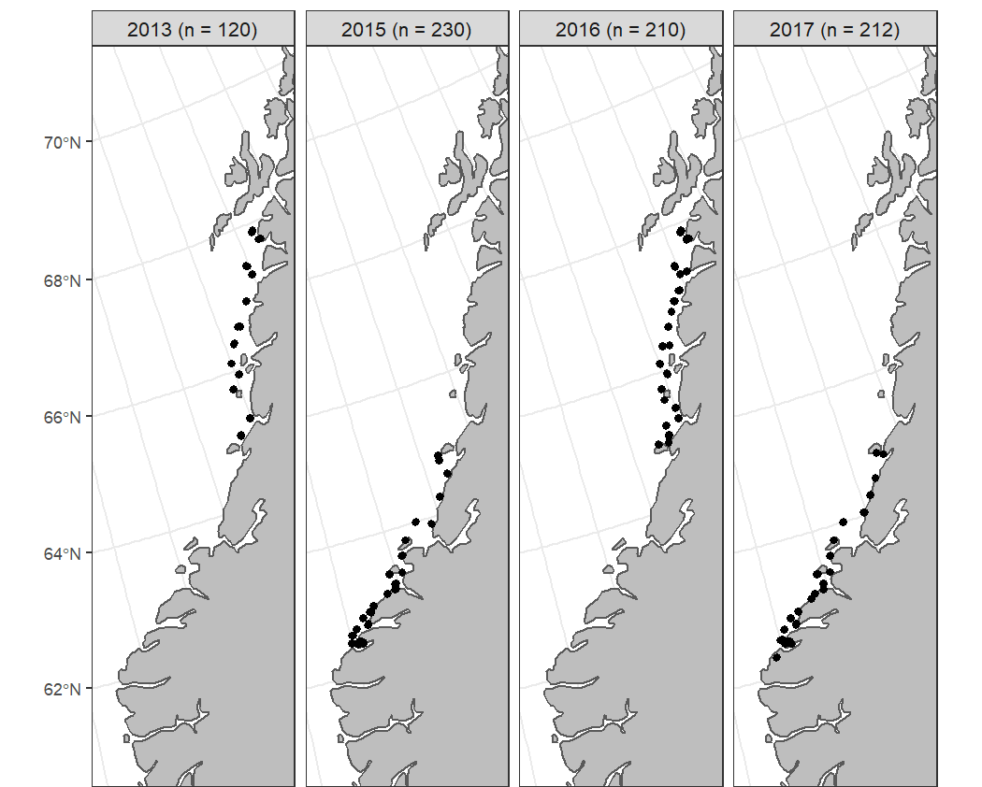
Shallow net survey
Use sdmTMB to create an abundance index
What covariates?
Which distribution (compare tweedie and delta_gamma)?
Account for every other year subarea sampling
Less data - compare simpler spatial structures than random fields
2. Manually define cross validation to account for site as the PSU
base_siteRE | biomass_kg ~ … + (1 | site)
base_lat | biomass_kg ~ … + lat
base_latsmooth | biomass_kg ~ … + s(lat)
base_2dsmooth | biomass_kg ~ … + s(lon,lat)
exercises/garn-ruse-ex/garn-ruse-ex-biomass-dg.R
exercises/garn-ruse-ex/garn-ruse-ex-biomass.R

Slide 6
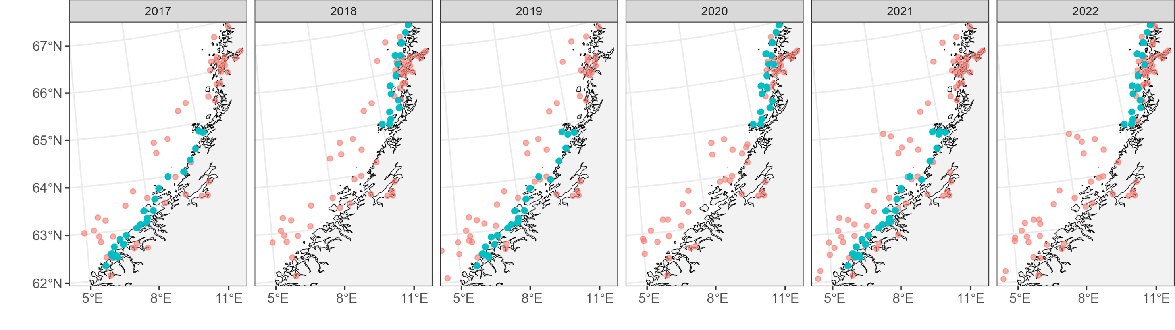
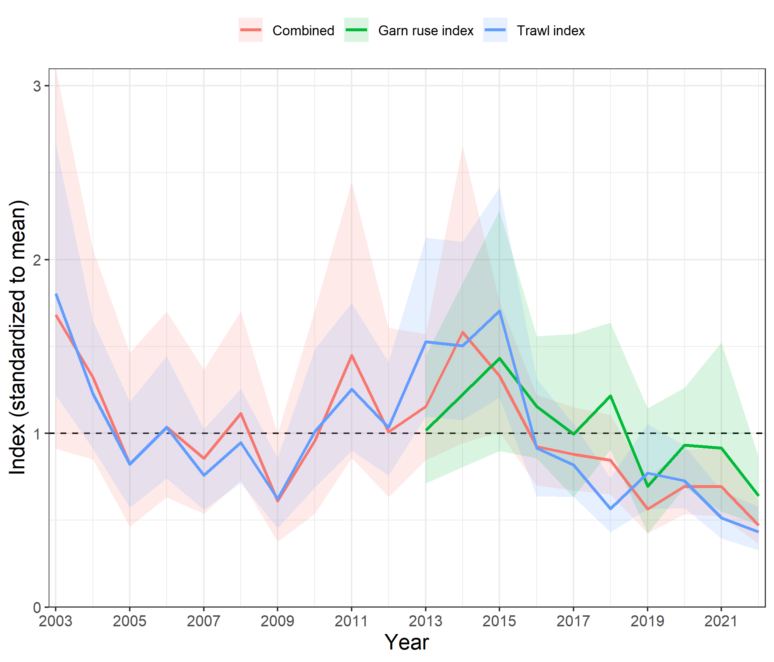
Can we combine the two surveys into one index?
Does a combined index have lower CV?
exercises/combine-surveys/combine-surveys.R

Slide 7
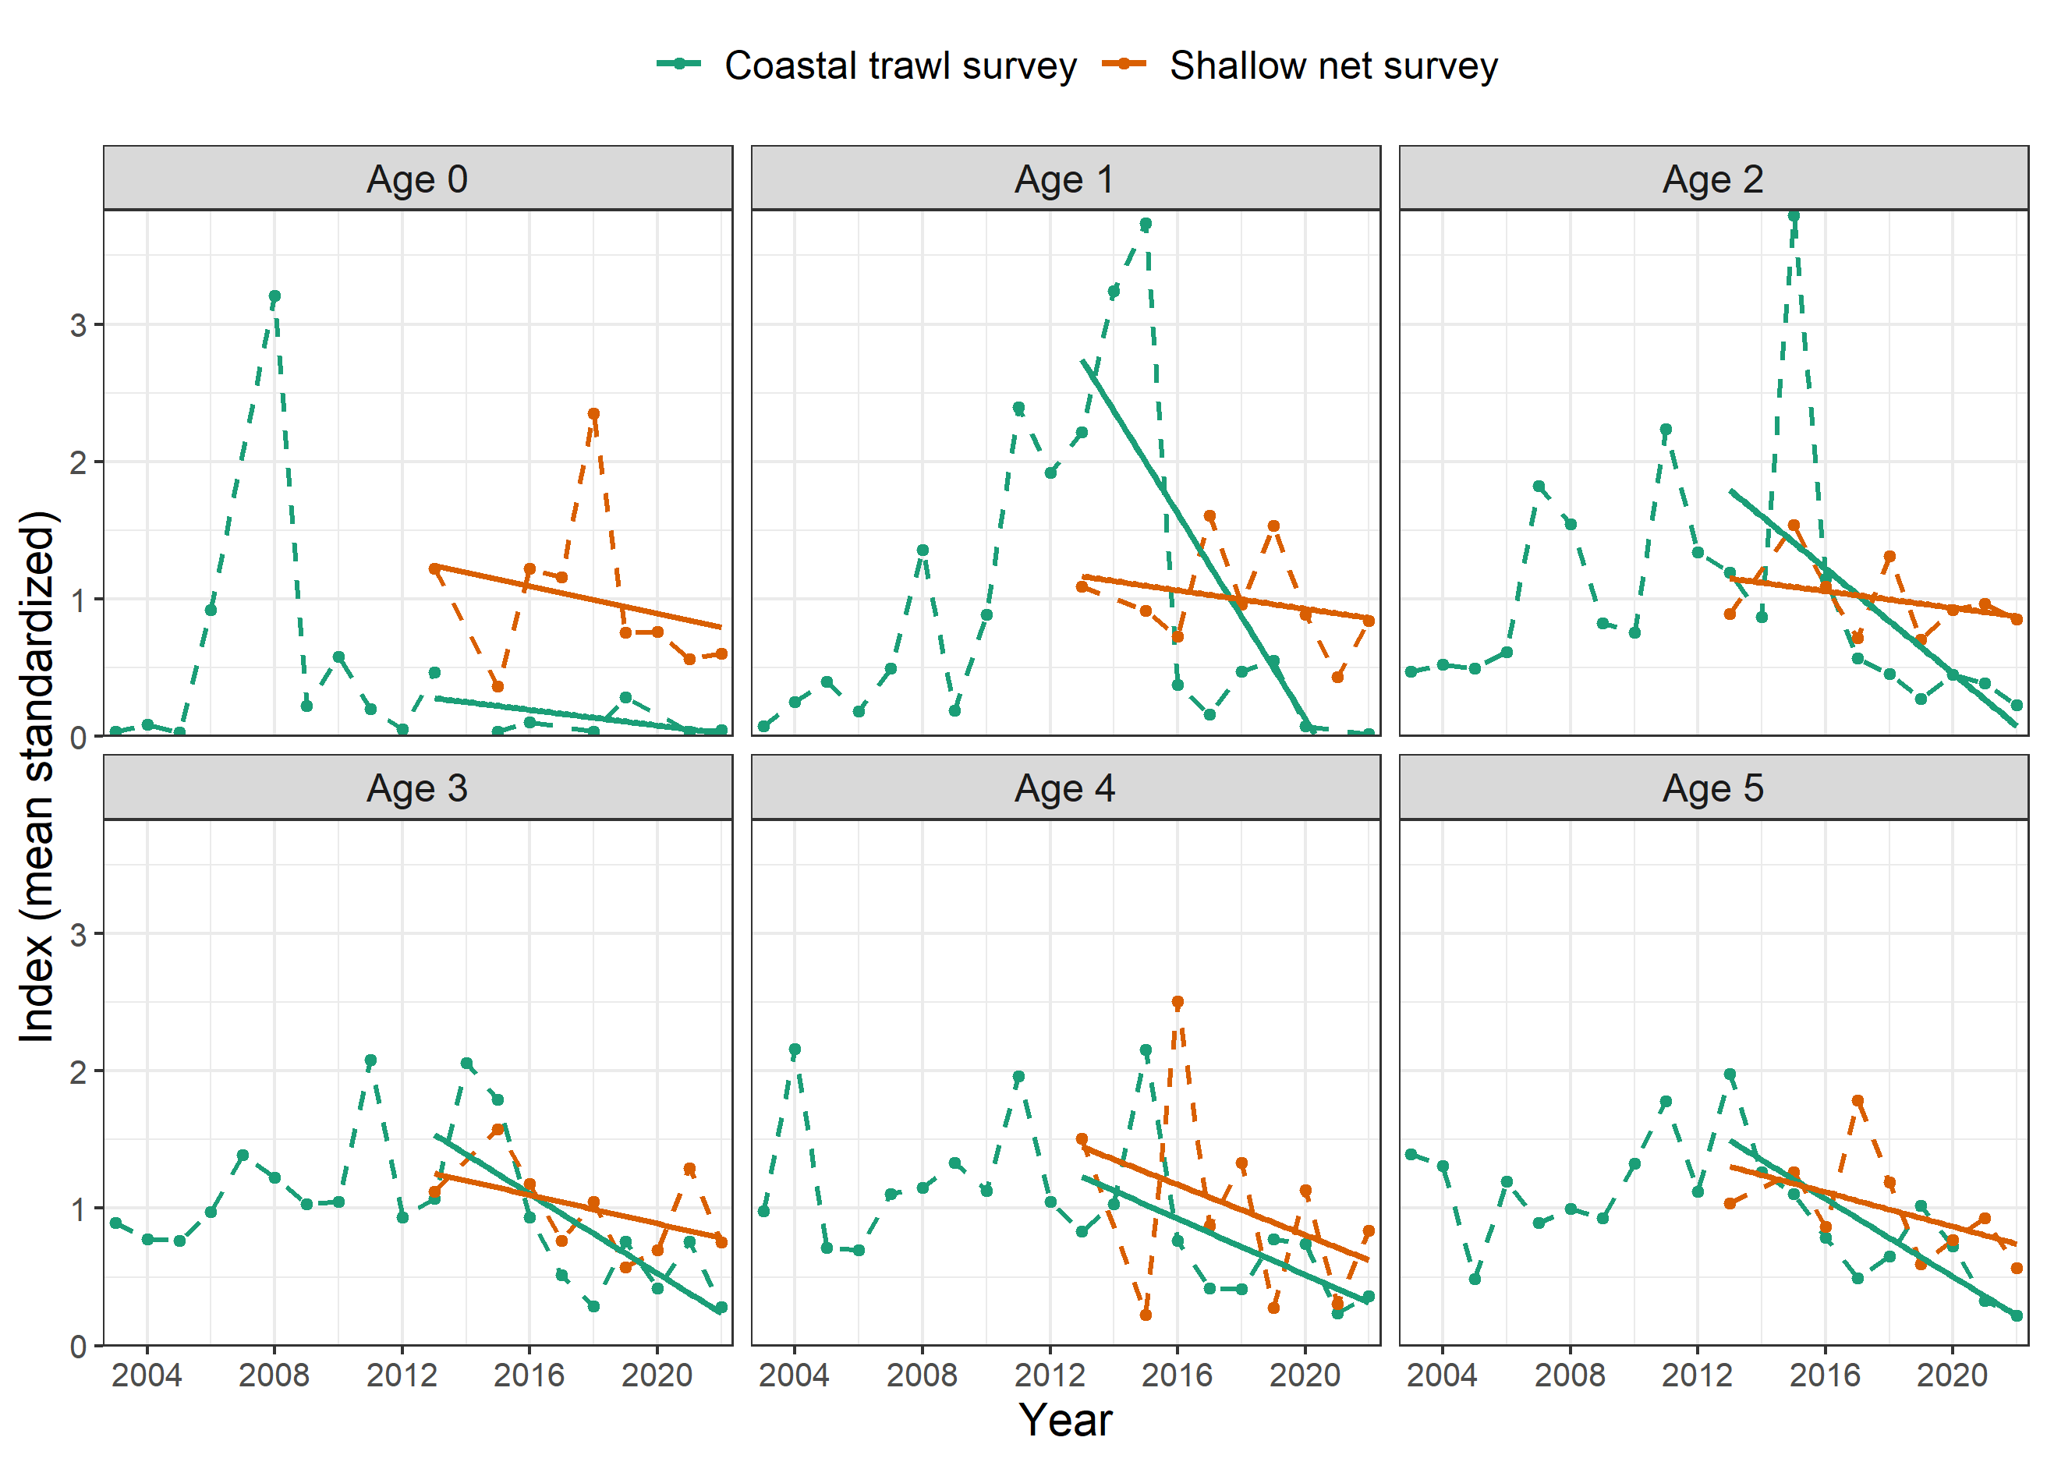
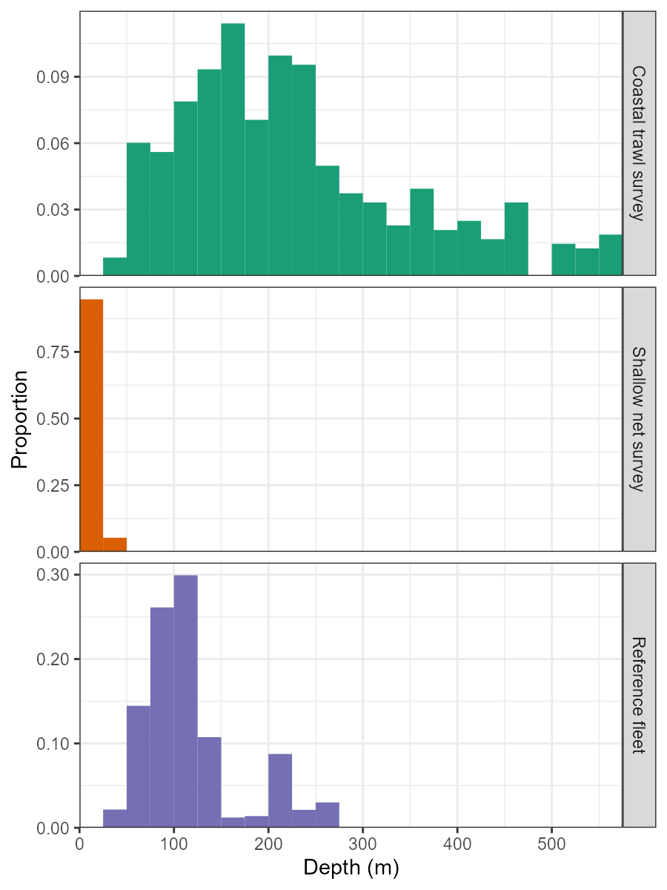
Can we combine the two surveys into one index?
Consistent trends at all ages 0-5…
… but they sample very different habitat/depth

